Slide 1
Module 3 String Matching Algorithms

Slide 2
Topics
Module:3 String Matching Algorithms
Naïve String-matching Algorithms
KMP algorithm
Rabin-Karp Algorithm
Suffix Trees.

Slide 3
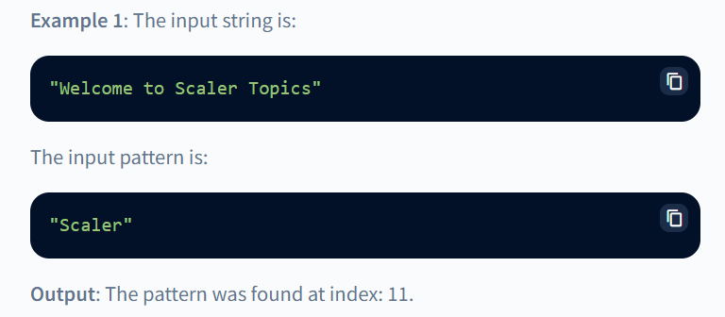
String Matching algorithm
The problem states that we are given a text string (let's say text) having the length n and a pattern string (let's say pattern) having the length m
We need to write a function that takes these two strings (pattern, and text) and prints all the occurrences of the pattern string in the text string
We can assume that the value of m will always be less than the value of n.
We can assume 0-based indexing.
Example:

Slide 4
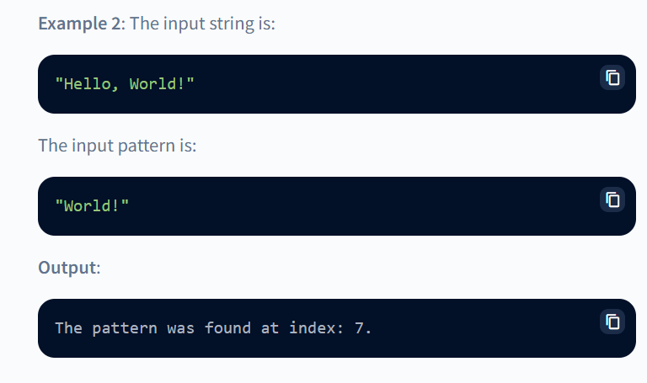

Slide 5
STRING:
A string is an immutable data type that is used to store the sequence of characters
Strings are one of the most widely used data types of any programming language
A string can be easily created using quotes (either single quotes or double quotes)
Naive string matching algorithm:
In the example above, the input string is "Hello World! and the pattern that needs to be searched is "World!“
We can see that the size of the pattern is 6 (say, m) and the size of the input text is 12 (say, n)
We can start searching for the pattern in the input text by sliding the pattern over the text one by one and checking for a match.
So, we would start searching from the first index and slowly move our pattern window from index-0 to index-6
At index-6, we can see that both the W's are matching. So, we will search the entire pattern in the window starting with index-6.

Slide 6
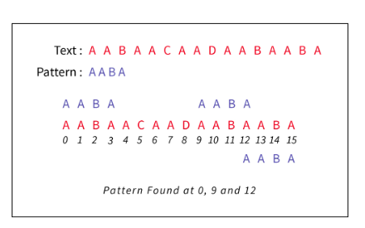
Hence, we will find a match and return the starting index of the pattern as the answer
For better clarity of the window search, please refer to the image provided below

Slide 7
Best Case
The best case in the naive string-matching algorithm is when the required pattern is found in the first searching window only
For example, the input string is: "Scaler Topics" and the input pattern is "Scaler
We can see that if we start searching from the very first index, we will get the matching pattern from index-0 to index-5. So, we would return 0 as the answer.
In the best-case scenarios, we have only searched a smaller section of the entire string
We need not traverse the entire input string.
In the best case, we need to perform the O(1 + m)a number of comparisons, m for comparing the pattern string in the window and 11 comparison for the first character of the input string text with the pattern string's first character
Here, m is the size of the input pattern string.

Slide 8
Worst Case
The worst case in the naive string-matching algorithm is when the required pattern cannot be found in the entire input string.
For example, the input string is: "Scaler Topics" and the input pattern is "Interview Bit”
We can see that if we start searching from the very first index and traverse the entire input string but we cannot find any matching.
In the worst-case scenario, we need to traverse the entire input string.
In the worst case, we need to perform the O(m*(n-m+1)) number of comparisons, where n is the size of the input string and m is the size of the input pattern string

Slide 9
Naive Pattern Searching
One approach to search a certain pattern in the input string can be using two loops (nested loops)
We will use all the possible placements of the pattern string in the input text and check whether the current positioning matches the input pattern or not
If the current positioning matches with the input pattern, then we would return the first index of the matching window (of input text)
If all the possible positioning does not match with the input string, then we would return -1−1

Slide 10
This is simple and efficient brute force approach
It compares the first character of pattern with searchable text
If a match is found, pointers in both strings are advanced
If a match is not found, the pointer to text is incremented and pointer of the pattern is reset.
This process is repeated till the end of the text.
The naïve approach does not require any pre-processing
Given text T and pattern P, it directly starts comparing both strings character by character.
After each comparison, it shifts pattern string one position to the right.
Following example illustrates the working of naïve string-matching algorithm. Here,
T = PLANINGANDANALYASIS and P = AND
Here, t_{i} and p_{j} are indices of text and pattern respectively.

Slide 11
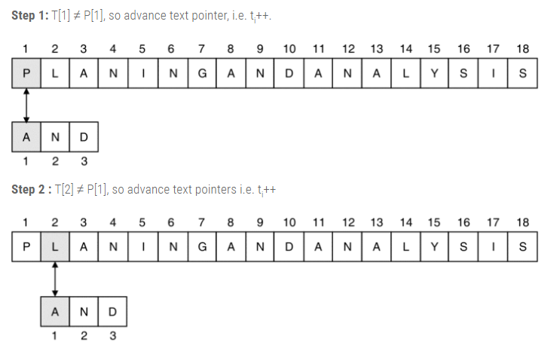

Slide 12
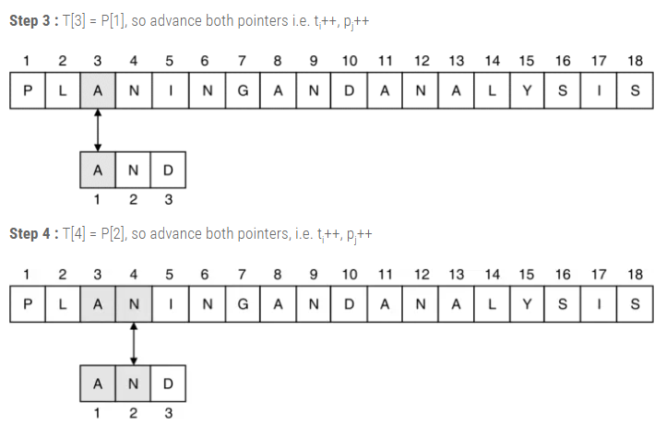
Cont’d

Slide 13
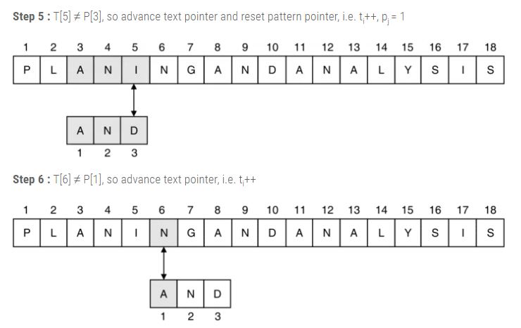
Cont’d

Slide 14
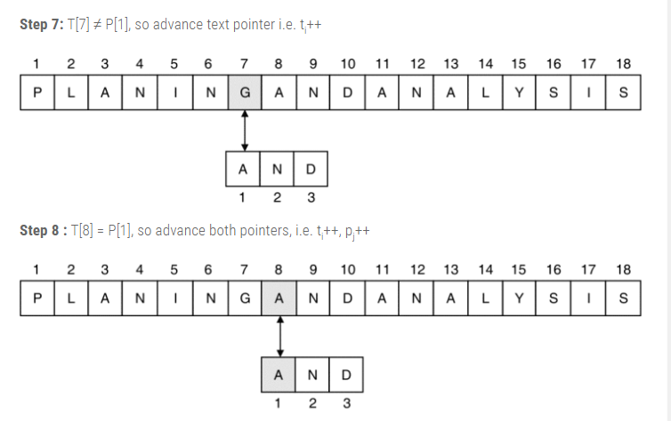
Cont’d

Slide 15
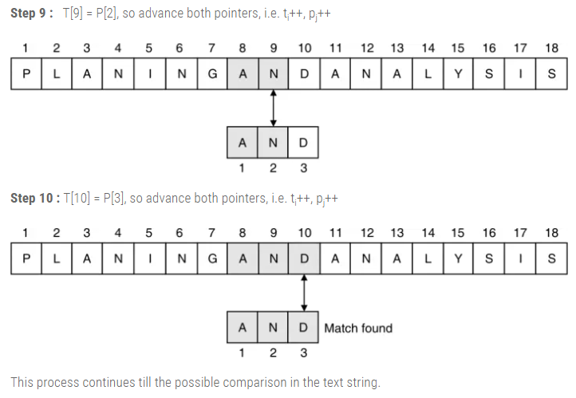
Cont’d

Slide 16
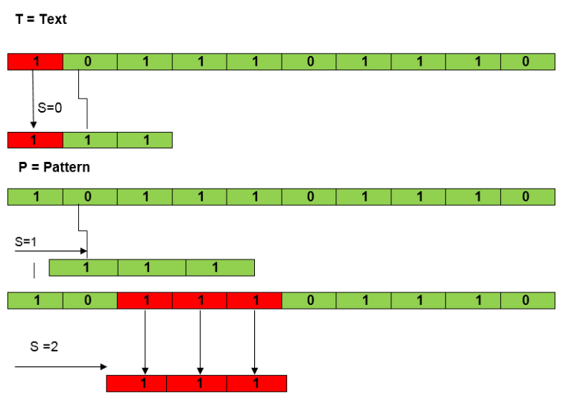
Ex :2

Slide 17
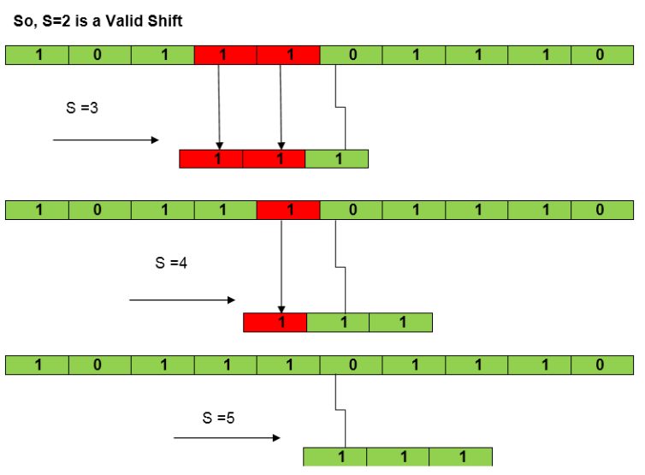

Slide 18
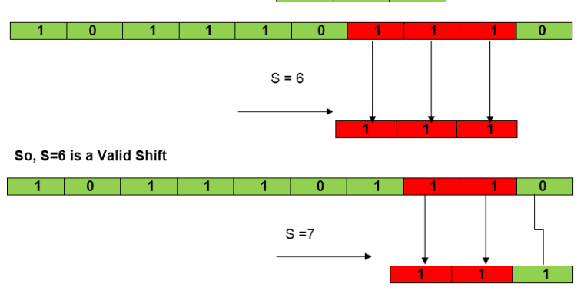

Slide 19
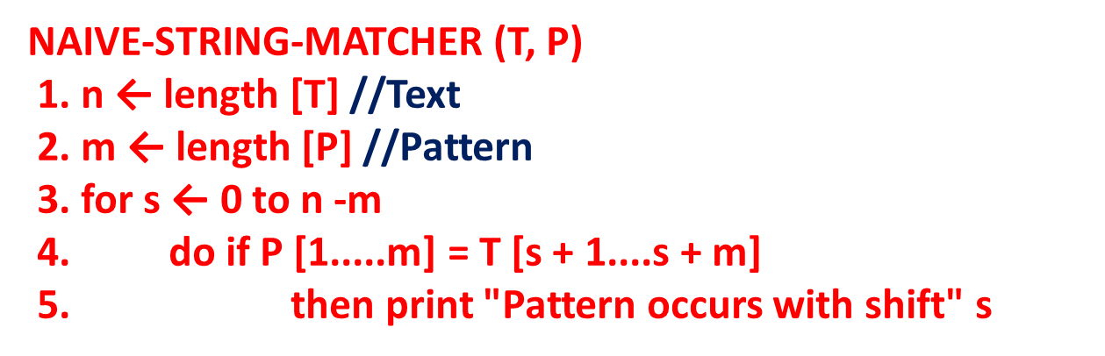
The Naive String Matching Algorithm
The naïve approach tests all the possible placement of Pattern P [1.......m] relative to text T [1......n]. We try shift s = 0, 1.......n-m, successively and for each shift s. Compare T [s+1.......s+m] to P [1......m].
The naïve algorithm finds all valid shifts using a loop that checks the condition P [1.......m] = T [s+1.......s+m] for each of the n - m +1 possible value of s.
Analysis: This for loop from 3 to 5 executes for n-m + 1(we need at least m characters at the end) times and in iteration we are doing m comparisons. So the total complexity is O [(n-m+1)*m] → O(nm).

Slide 20
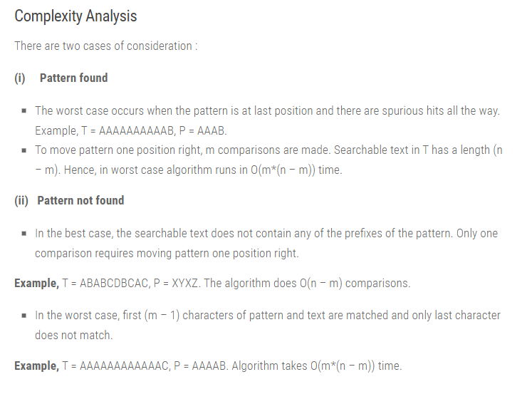

Slide 21
Advantages:
No Pre-processing phase required because the running time of Naive-String-Matcher is equal to its matching time.
No extra space are needed.
Also, the comparisons can be done in any order.
Disadvantage:
Naive method is inefficient because information from a shift is not used again.

